Slide 1
Pilot - Incremental Learning
Pramit Kumar Bhaduri

Slide 2
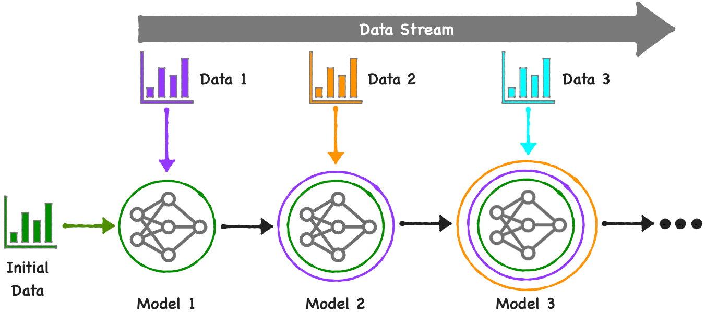
Introduction - what is Incremental Learning?
Notes:
Incremental learning( also called continual learning) is a methodology of machine learning where an AI model learns and enhances its knowledge progressively, without forgetting previously acquired information. In essence, it imitates human learning patterns by acquiring new information over time, while maintaining and building upon previous knowledge. Incremental learning is crucial in scenarios where data arrives in sequential order or where the storage of all data for processing is not feasible.

Slide 3
Introduction - what are (some of) the benefits?
Efficient use of resources.
Real-time adaptation.
Efficient learning.
Learning from non-stationary data
Notes:
Efficient use of resources. Incremental learning models need to store less data at a time, which can lead to significant memory savings. For instance, a fraud detection system in a bank can update its model with each transaction, rather than storing all transactions to process them later.
Real-time adaptation. These models can adapt to changes in real-time. If we take the example of an AI-based news recommendation system, it can learn a user's changing preferences over time and recommend articles based on their most recent interests.
Efficient learning. Breaking a task into smaller parts can enhance the machine learning model's ability to learn new tasks quickly and effectively. Moreover, incremental learning is beneficial in improving the accuracy of the models.
Learning from non-stationary data. In a world where data can evolve rapidly, incremental learning models are highly valuable. A weather prediction model, for example, can continuously adapt its forecasts based on the most recent climate data.

Slide 4
Introduction - what are (some of) the limitations?
Catastrophic forgetting (!!)
Difficulty in handling concept drift
Risk of overfitting
Notes:
Catastrophic forgetting. One of the main challenges of incremental learning is "catastrophic forgetting," where the model tends to forget old information as it learns new data.
Difficulty in handling concept drift. Although incremental learning is designed to handle evolving data, handling abrupt changes or 'concept drift' in data trends can be challenging.
Risk of overfitting. Since incremental learning relies on a stream of data, it could over-adjust its parameters based on recent data, which might not represent the overall distribution. For instance, a stock prediction model could become overly sensitive to short-term market fluctuations, leading to less accurate long-term predictions.

Slide 5
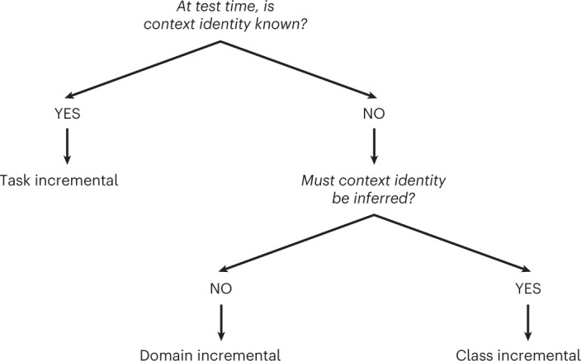
Introduction - what are the types?
Notes:
Next we see how we can categorize different possible learning scenarios. It all starts with one simple question at the top of this chart: when the model is being tested, does it actually know which 'context' or task it’s currently looking at? If the answer is 'yes,' then we’re in Task-Incremental Learning. This is the most straightforward version because the model is basically given a 'heads-up' telling it which specific set of rules to apply. Now, if the model doesn't know the context, we have to ask a follow-up question: does it actually need to figure that context out to get the right answer? If the answer is 'no'—meaning the model can solve the problem regardless of the environment it's in—that’s Domain-Incremental Learning. But, if the model is flying blind and has to correctly infer the context on its own just to distinguish between different classes, then we've reached Class-Incremental Learning, which is by far the most complex challenge in incremental learning.

Slide 6
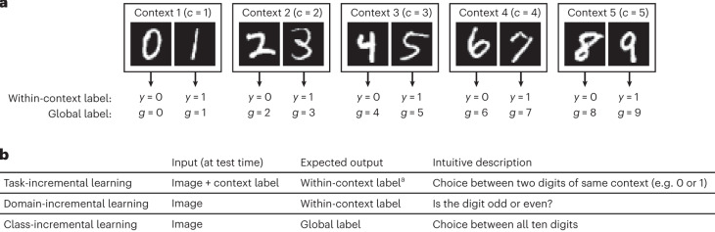
Introduction - what are the types?
Notes:
Next, To make these concepts feel a bit more real, we can see how this plays out with a standard digit-recognition task like MNIST. Imagine we’ve split the digits 0 through 9 into five separate pairs, which we call 'contexts'. In Task-Incremental Learning, the model gets both the image and the context label, so its job is really just choosing between two digits at a time, like 'is this a 0 or a 1'? It’s very controlled. Moving to Domain-Incremental Learning, the model only sees the image, but the output it needs to give is a general rule that applies across the board. A good way to understand this is the model simply asking 'is this digit odd or even'? It doesn't need to know if the digit came from the first group or the fifth group to give you the right answer. Finally, Class-Incremental Learning is the most lifelike and difficult scenario. The model just gets the image and has to provide a 'global label,' meaning it has to choose correctly from all ten digits at once. It essentially has to figure out the context on its own to make sure it doesn't mix up a 1 from the first task with a 7 from a much later one.

Slide 7
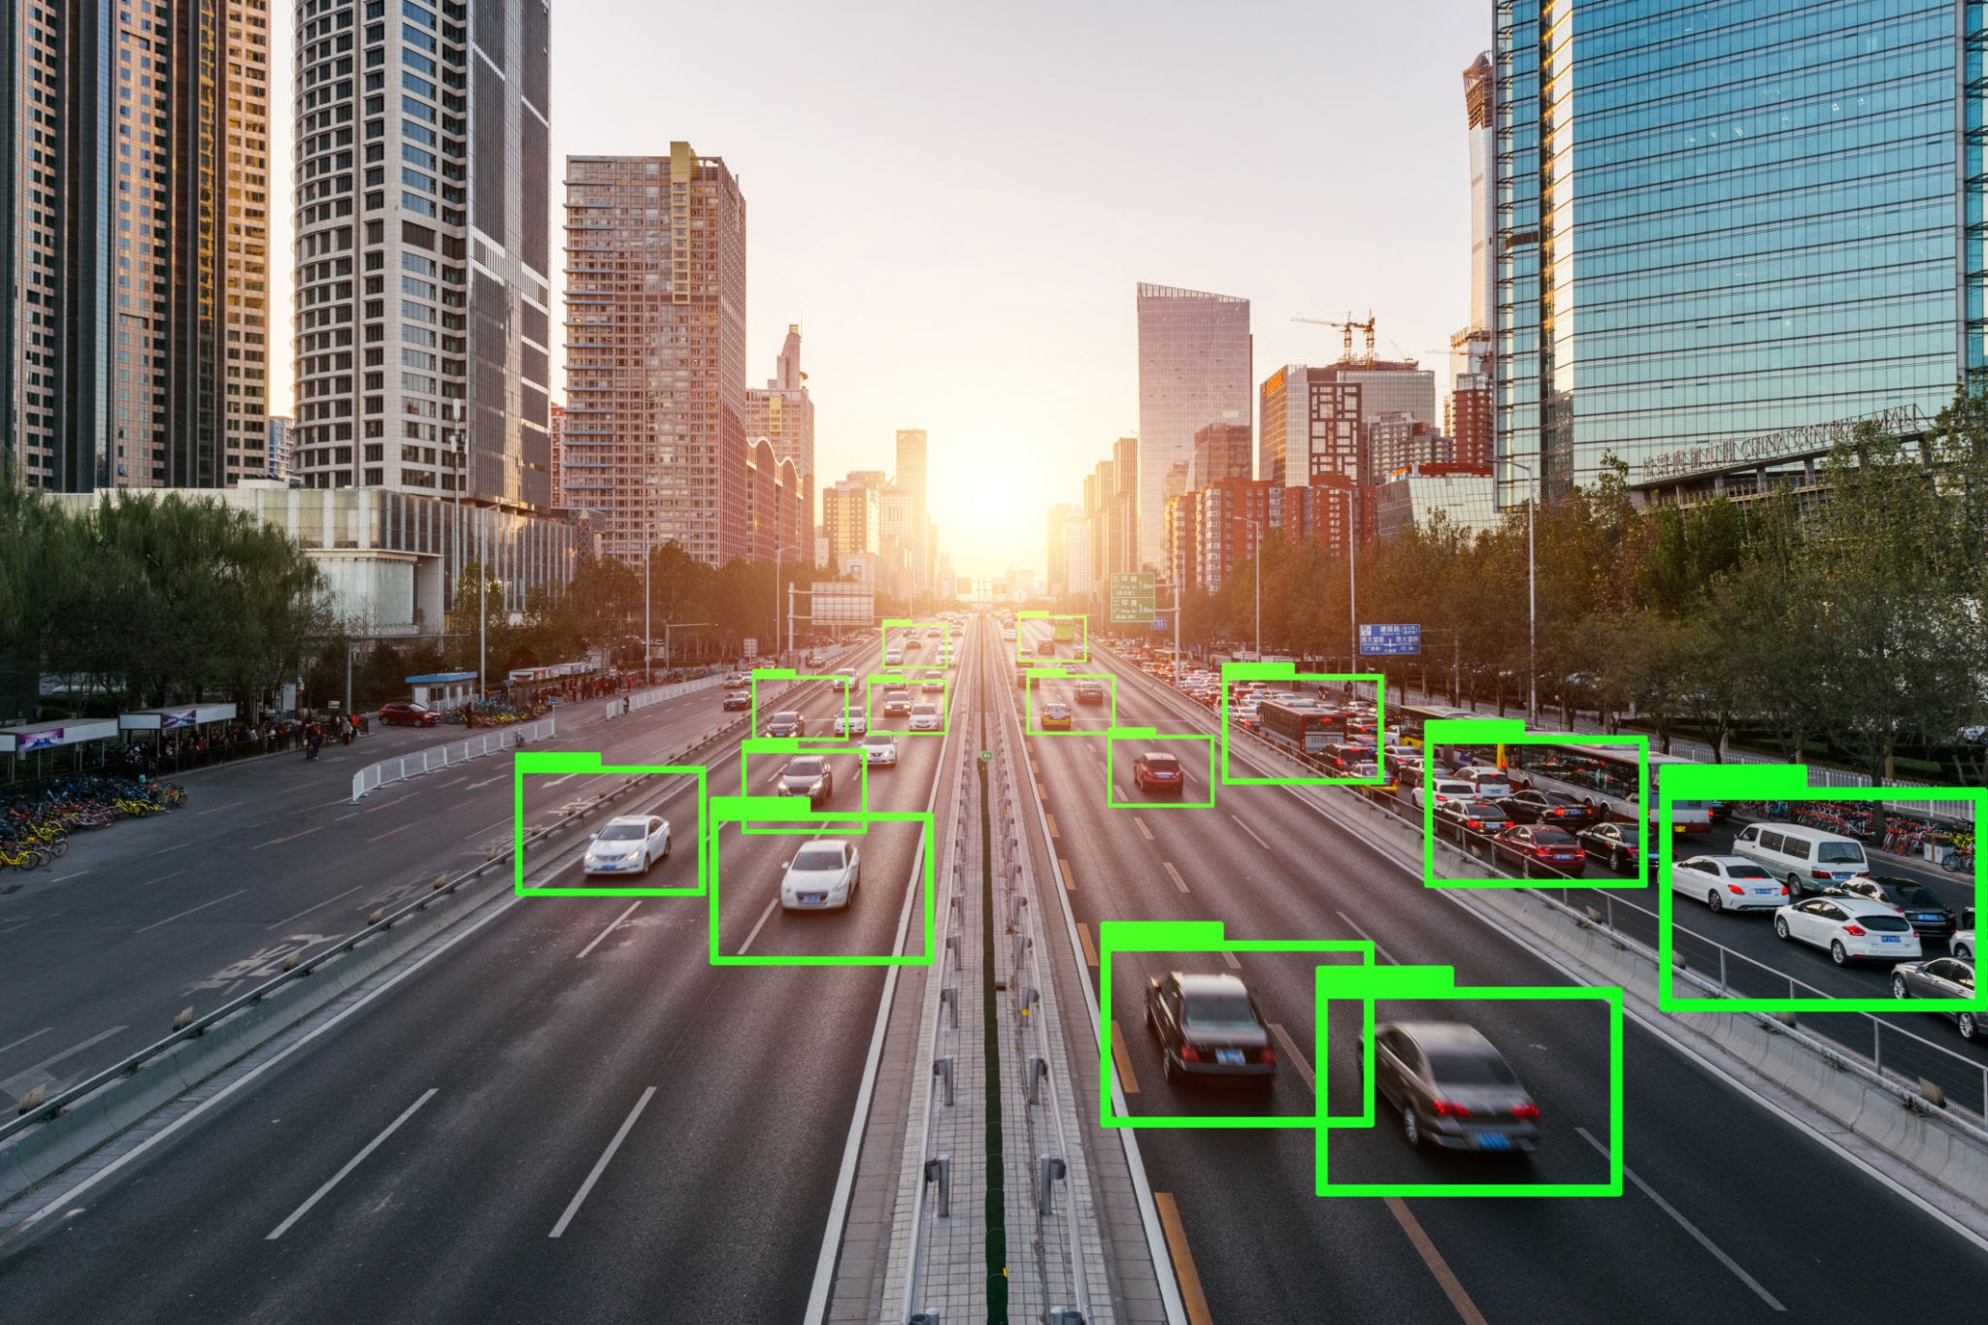
Introduction - real world applications
Autonomous Vehicles
News Recommendation Systems
Fraud Detection in Banking
Resource constrained devices!
Notes:
For self-driving cars, incremental learning plays a pivotal role in enhancing the vehicle's understanding of its surroundings. We can Take the example of Tesla's Autopilot system. The cars are designed to learn incrementally from the vast amount of data collected from the fleet of Tesla vehicles on the road.
Online news platforms use incremental learning to personalize content for their readers. This feature uses incremental learning to understand a user's reading habits and preferences over time.
Banks use incremental learning algorithms to detect fraudulent transactions, such as the real-time fraud detection system used by Mastercard. With every transaction, Mastercard's system analyzes over 100 different variables (like transaction size, location, and merchant type) to assess the likelihood of fraud.
And finally the opportunity of its application in resource constrained devices. Small, low-power gadgets can use something called TinyML to learn new habits directly on the device instead of relying on a constant cloud connection. This allows a health tracker to recognize specific heart patterns or a factory sensor to learn new signs of machine trouble right as they occur or a satellite in space!
What is TinyML? TinyML is a subset of machine learning designed to run on small, low-power devices, such as microcontrollers. TinyML enables models to run directly on embedded devices with limited memory, storage and processing capabilities.

Slide 8
Paper #1 - Class Incremental Learning from First Principles: A Review
Authors: Ashtekar, Zhu, and Honavar (published in TMLR, January 2025)
Intent: The paper provides a re-evaluation of Class-Incremental Learning (CIL) by moving away from purely algorithmic descriptions and focusing instead on "first principles"—the fundamental logical and mathematical constraints of the problem.
Background: The authors argue that most existing CIL research is fragmented and lacks a unified theoretical framework. They aim to consolidate this by defining CIL based on resource constraints (memory, computation) rather than just the sequence of data.
Core Goal: To clarify the "stability-plasticity dilemma" and provide a structured taxonomy that helps researchers understand why certain methods work, rather than just that they work.
Notes:
Now, we’re going to dive into our first paper, which is a very recent review from early 2025 by Neil Ashtekar and his team at Penn State. The reason we chose this paper is that it does something different—instead of just listing new algorithms, it asks us to go back to 'First Principles'.
Basically, the authors felt that research in Class-Incremental Learning, or CIL, has exploded lately, but it’s becoming really fragmented. We have all these new methods, but no unified way to talk about the basic rules that make the problem hard.
The Intent of this paper is to re-evaluate CIL by looking at the fundamental logical and math-based constraints. In the Background section, they make a really bold point: they say the standard way we define CIL is actually a bit imprecise. They want to redefine the whole field based on Resource Constraints—like memory and compute power—rather than just whether 'old data' is available or not.
The Core Goal here is to clear up the 'stability-plasticity dilemma,' which is that constant tug-of-war between keeping old knowledge and learning new things. They want to provide a clear map, or taxonomy, that helps us understand why certain methods work instead of just showing that they do.

Slide 9
Paper #1 - The Approach
Resource-Centric Definition: The authors redefine CIL not just as "learning new classes" but as a problem of constrained optimization. They categorize methods based on how they manage memory (data storage) and computational time.
The Stability-Plasticity Dilemma: Their approach centers on how models balance Stability (retaining old knowledge) with Plasticity (absorbing new information).
Taxonomy of Methods: They group CIL methods into three strategic buckets:
  Replay-based: Keeping a small "buffer" of old data to remind the model.
  Regularization-based: Adding penalties to the learning process to prevent old weights from changing too much.
  Architecture-based: Changing or expanding the model’s physical structure (like adding new "heads" or layers) as new classes arrive.
Notes:
On this slide, we’re looking at how the authors actually frame the problem of Class-Incremental Learning. They start with a Resource-Centric Definition (Section 2.2.2, Page 4). Instead of just worrying about whether old data is available, they want us to treat this like a math problem where we have strict limits on our hardware—specifically how much memory we have to store things and how much computing time we have to retrain (Section 2.1, Page 3).
Everything in their approach centers on the Stability-Plasticity Dilemma (Section 1, Page 1). It’s basically a tug-of-war: we need "stability" so we don't forget the old stuff, but we also need "plasticity" so we can actually learn new info without getting stuck in our ways (Section 3.1, Page 6).
To keep all the different AI solutions organized, the authors have grouped them into three main "strategic buckets" or a Taxonomy (Section 3, Page 3). First, there's Replay, which is like keeping a "highlight" of old data to refresh the model’s memory (Section 5.1, Page 12). Then there's Regularization, where we add penalties to the learning process to stop the most important parts of the model's brain from changing too much (Section 5.1, Page 12). And finally, we have Architecture-based methods—also called parameter isolation—where we actually change the physical structure of the model by adding new layers or "heads" every time we introduce a new class (Section 5.2, Pages 13-14).

Slide 10
Paper #1 - Challenges
Catastrophic Forgetting: This remains the primary technical hurdle; when a model learns class "C," it often "overwrites" the logic it used for classes "A" and "B".
Implementation-Dependent Results: The authors highlight a major challenge in the field: results often vary wildly depending on the specific ordering of tasks or the starting classes, making it hard to compare different algorithms fairly.
The "Context Identity" Problem: A major challenge is that in Class-IL, the model is not told which task the data belongs to during testing. It must infer the context, which often leads to confusion between similar classes from different time periods.
Metric Flaws: They point out that current metrics (like "Final Accuracy") often hide the true performance costs, such as how much a model’s efficiency degrades over time.
Notes:
Next we look at the challenges. First, there's the classic problem of Catastrophic Forgetting. This is basically when our model learns a new class, like 'Class C,' and in the process, it accidentally 'overwrites' the logic it used to recognize the older classes 'A' and 'B'.
Another huge issue the authors point out is Implementation-Dependent Results. It turns out that a model's performance can change wildly just based on the order of the tasks we give it or which classes we group together. This makes it really hard for us to compare different algorithms fairly because one might look great on one task sequence but fail on another.
Then we have the 'Context Identity' Problem. as we don't tell the model which 'task' it's looking at during the test phase. It has to figure out the context on its own, which often leads to it getting confused between similar-looking classes that it learned at totally different times.
Finally, the paper warns us about Metric Flaws. They argue that just looking at 'Final Accuracy' doesn't tell the whole story. It can hide the true cost of learning, like how much the model's efficiency drops over time or how much 'memory' it's actually using behind the scenes."
Support Information for Q&A
Catastrophic Forgetting (Section 3.1, p. 6): The authors formally define this as the degradation of model performance on old tasks as new tasks are learned. It’s the 'Stability' side of the stability-plasticity dilemma.
Across-Task Discrimination (Section 3.1, p. 7): This is the core of the 'Context Identity' problem. CIL requires the model to discriminate classes both within a task and across every task it has ever seen.
Ordering and Assignment (Section 6, pp. 16-17): The authors show that the specific assignment of classes to tasks and the order in which those tasks appear (Task Order) are major dimensions that influence how 'hard' a CIL problem actually is.
Performance Metrics (Section 3.1, pp. 6-7): To address metric flaws, the paper suggests using specific measures like Forgetting (F), Intransigence (I), and Across-Task Discrimination (ATD) to get a more honest picture of how a model is performing.

Slide 11
Paper #2 - LoRA-Edge: Tensor-Train-Assisted LoRA for Practical CNN Fine-Tuning on Edge Devices
Authors: Hyunseok Kwak, Kyeongwon Lee, Jae-Jin Lee, and Woojoo Lee (Accepted for DATE 2026)
Intent: To introduce LoRA-Edge, a parameter-efficient fine-tuning (PEFT) framework that adapts the multi-dimensional structure of CNNs to edge devices without increasing inference costs.
Background: Edge applications like Human Activity Recognition (HAR) suffer from "domain shift" when used in the wild (e.g., changes in sensor placement or user motion). Full fine-tuning of these models on-device is usually impossible due to extreme memory, compute, and power limits.
Core Goal: To create a method that preserves the original convolutional structure, minimizes trainable parameters, converges much faster than random initialization, and ensures inference costs remain identical to the original model.
Notes:
Our second paper is a very recent study by Hyunseok Kwak and his team from Korea, which will be published in early 2026. While our first paper looked at high-level learning logic, this one gets very practical. We’re talking about LoRA-Edge, a way to help small gadgets like smartwatches update their 'brains' on the fly so they can adapt to new users without needing a massive amount of memory or power.
The big issue here is something called domain shift. This happens when a fitness tracker, for example, starts getting things wrong just because a different person is wearing it or the sensor moved slightly. Usually, you'd have to retrain the whole model to fix this, but these tiny devices simply don't have the memory or the battery life for that.
The goal of LoRA-Edge is to fix this by only updating a tiny fraction of the model—less than 1.5% of its parameters. This allows the device to adapt to new environments much faster, all while keeping the actual processing speed exactly the same
QnA
What is HAR?: It stands for Human Activity Recognition. It transforms signals from wearable sensors into actions like healthcare or fitness tracking.
Why not use standard LoRA?: Standard LoRA was made for linear layers in language models. Forcing it onto CNNs (convolutional layers) causes the parameter count to explode because it doesn't align with the multi-dimensional structure of the weight tensors.
Key Performance Results: The method achieved accuracy within 4.7% of a full fine-tuning but only updated 1.49% of the parameters.
Efficiency Gains: On actual hardware (the Jetson Orin Nano), LoRA-Edge reached its target performance 1.4x to 3.8x faster than previous methods.

Slide 12
Paper #2 - The Approach
TT-SVD Initialization: Instead of starting from scratch (randomly), LoRA-Edge applies Tensor-Train Singular Value Decomposition (TT-SVD) directly to pre-trained weights. This preserves the rich features the model already learned during its original training.
Selective Core Training: For a 4D weight tensor (standard in CNNs), the model produces a series of "cores." LoRA-Edge updates only the core nearest to the output side while keeping the others frozen.
Zero-Initialization Strategy: The method zero-initializes the trainable core so that the new "learning path" starts inactive, preventing the model's output from jumping erratically at the very beginning of training.
Seamless Fusion: Once fine-tuning is finished, the updated cores are fused back into the original dense weights. This means the hardware performing the actual task sees no change in model size or speed during deployment.
Notes:
Now, let’s look at exactly how LoRA-Edge works. this method uses something called TT-SVD Initialization. This basically takes the pre-trained weights the model already has and decomposes them into a more efficient structure, which helps it keep all the useful features it learned during its original training.
Once the model is broken down into these smaller pieces—which the authors call 'cores'—they use a Selective Core Training strategy. For standard CNNs, which use 4D weight tensors, the method only updates the single core closest to the output side while keeping all the others frozen. This avoids a major 'gradient bottleneck' where important information gets lost if you try to update too many parts at once.
They also use a Zero-Initialization Strategy for that one trainable core. This makes sure that when training starts, the new 'learning path' is basically silent, so the model’s output doesn't jump around erratically right at the beginning.
Finally, we have Seamless Fusion. Once the fine-tuning is done, these updated cores are fused back into the original weights. This is the 'magic trick' of the method—it means that the gadget performing the actual task sees absolutely no change in its speed or model size during deployment."
(Q&A Support)
What is TT-SVD?: It stands for Tensor-Train Singular Value Decomposition. It’s a mathematical way to factorize a high-order tensor into a sequence of 3D cores while controlling the parameter budget through rank truncation.
Why only update the output-side core?: The authors discovered a "gradient-rank bottleneck". If you update cores near the input, the gradient information loses its "strength" or rank as it travels through the frozen cores. Updating the output core (the first core) keeps the most information intact.
Does this change the model architecture?: No. Because of the fusion step, the auxiliary path used for training is merged back into the base weights. This keeps the inference-time FLOPs and memory footprint identical to the unadapted model.
How small is the trainable part?: In a standard example provided by the authors, it reduces the trainable count from over 36,000 parameters to just 128, which is only about 0.35% of the original size.

Slide 13
Paper #2 - Challenges
The Flattening Mismatch: Standard LoRA was built for language models (linear layers). Applying it to CNNs usually requires "flattening" tensors into matrices, which causes the number of parameters to explode as kernel sizes increase.
Cold-Start Convergence: Traditional Tensor-Train methods use random initialization, which forces the model to re-learn features from zero. This "cold start" consumes too much energy on battery-powered edge devices.
Gradient Bottlenecks: When using small ranks to save space, gradient information can get lost as it travels through multiple cores. LoRA-Edge specifically identifies the output-side core as the most impactful area to update to avoid this bottleneck.
F1 Performance Gap: The challenge of achieving high accuracy (within 4.7% of a full fine-tuning) while only updating about 1.5% of the total parameters.
Notes:
To wrap up our look at LoRA-Edge, we need to talk about the technical hurdles the authors had to solve. The first big one was the Flattening Mismatch. Standard LoRA was really built for the linear layers we find in language models. If we try to force it onto a CNN by 'flattening' its multi-dimensional structure into a flat matrix, the number of parts you have to update actually explodes as the kernels get bigger, making it too heavy for a small device.
Then there’s the Cold-Start Convergence problem. Older methods often start with random guesses, which forces the model to re-learn everything from zero. On a battery-powered device, that 'cold start' just wastes way too much energy.
Another roadblock was Gradient Bottlenecks. When we use very small ranks to save space, the important gradient information can actually get 'lost' as it travels through the model. The authors solved this by specifically targeting the output-side core as the most impactful place to make updates.
Finally, there’s the F1 Performance Gap. The ultimate challenge was getting high accuracy while barely touching the model. They managed to get within 4.7% of the accuracy of a full retraining, even though they only updated about 1.5% of the total parameters."
Q&A Support
Why is "flattening" bad for CNNs?: CNN weights are 4-dimensional (output channels, input channels, and k×k spatial dimensions). Flattening ties the rank to the kernel size, causing trainable parameters to grow quadratically with the kernel size (k2).
What is the "Output-Side Core"?: In a 4D tensor, the cores are sequential. The "output-nearest" core (G(1)) relates directly to the output channels. Training this core avoids the "gradient rank loss" that happens when gradients pass through too many other small-rank cores.
How do they measure F1?: Since HAR datasets are often imbalanced (some activities happen more than others), they use macro F1-score as the primary metric to ensure the model performs well across all activity types, not just the common ones.
Real-World Speed: On a Jetson Orin Nano, this specific approach yielded 1.4x to 3.8x faster convergence to the target F1 score compared to previous methods.

Slide 14
Paper #3 - A Review on Edge Large Language Models: Design, Execution, and Applications
Authors: Yue Zheng, Yuhao Chen, Bin Qian, Xiufang Shi, Yuanchao Shu, and Jiming Chen (February 2025).
Intent: This paper provides a comprehensive map of the entire lifecycle of "Edge LLMs"—from how we design them to how we actually run them on small devices.
Background: Large Language Models (LLMs) are revolutionary, but they are massive. Deploying them on "edge" devices—like smartphones or IoT sensors—is extremely difficult because these gadgets have very limited memory and computing power.
Core Goal: To bridge the gap between the power of LLMs and the reality of edge hardware by exploring efficient model design, pre-deployment strategies, and runtime optimizations.
Notes:
For our third paper, we’re looking at a brand-new review from February 2025 that tackles one of the biggest trends in tech: putting giant AI models, like ChatGPT, directly onto small devices. This is what we call Edge LLMs.
The Background here is pretty simple: LLMs are amazing at reasoning, but they are data-hungry giants. If we try to run one on a typical smartphone or a small sensor, we immediately hit a wall because of computational and memory constraints.
The Intent of this paper is to give us a 'bird's-eye view' of the whole process. It doesn't just look at one trick; it covers everything from the initial design to the final execution.
The Core Goal is to understand how we can bridge that gap—taking these massive models and shrinking them down so they can actually 'live' on the edge without losing their intelligence.

Slide 15
Paper #3 - The Approach
Lifecycle Phases: The paper breaks down the approach into three distinct stages: Design, Execution, and Application.
Resource-Efficient Design: Focuses on shrinking the models before they are even built, using techniques like Knowledge Distillation (teaching a small model to copy a big one) and Pruning (cutting out unnecessary connections).
Pre-deployment Strategies: Preparing the model for specific hardware using Quantization, which reduces the precision of the numbers the model uses to save massive amounts of memory.
Runtime Optimizations: Managing how the model actually thinks in real-time by optimizing the KV Cache (its short-term memory) and scheduling tasks to handle hardware limits.
Notes:
So, how do the authors suggest we actually get these giants onto small devices? They break their Approach into three lifecycle phases. Design, Execution, and Application
First, we have Resource-Efficient Design. This is about building the model 'lean' from day one. They talk about techniques like Knowledge Distillation, where a bigger' model helps a smaller model learn the same concepts. And Pruning
Next is Pre-deployment. Before the model even touches the device, they use Quantization. They reduce the mathematical precision of the model to save memory without losing the meaning.
Finally, they look at Runtime Optimizations. Once the model is running, it needs to be smart about its 'short-term memory,' or KV Cache. By managing this memory better, the device can respond much faster and handle longer conversations even with very little RAM.

Slide 16
Paper #3 - Challenges
Hardware Heterogeneity: Edge devices are all different (different chips, different power levels), making it impossible to create a 'one-size-fits-all' model.
Memory vs. Performance: Shrinking a model too much can lead to a 'stupidity' problem where it loses its reasoning abilities.
Latency Requirements: For applications like real-time translation, the model has to respond instantly, which is hard when the processor is small.
Privacy and Security: While edge AI is more private because data stays on-device, it introduces new risks of physical tampering or 'model extraction' attacks.
Notes:
To wrap up this paper, we have to look at the Challenges
The biggest one is Hardware Heterogeneity. Unlike a giant cloud server where everything is uniform, edge devices are all over the place—different chips, different batteries, different speeds. We can't just build one model and expect it to work on every phone and smartwatch.
There is also a constant battle between Memory and Performance. If we compress the model too much to save space, it might start 'hallucinating' or losing its logic.
Then there's Latency. If we’re using an edge LLM for a real-time voice assistant, it can't take five seconds to think. It has to be instant, which is a huge ask for a small processor.
Finally, even though edge AI is better for Privacy because your data never leaves your pocket, the paper warns that it opens up new security risks, like people trying to 'steal' the model's logic directly from the hardware."
Q&A
Why move to the Edge? (Section 1): To reduce latency, save bandwidth, and significantly improve user privacy by not sending data to the cloud.
What is Quantization? (Section 4): It involves converting 32-bit floating-point numbers into 8-bit or even 4-bit integers to reduce memory usage by 4x or more.
What are the main applications? (Section 5): Personal assistants, real-time language translation, and autonomous systems like drones or smart home controllers.
What is KV Cache optimization? (Section 4.3): It focuses on compressing the 'Key-Value' pairs that LLMs store during a conversation so they don't run out of memory during long chats.

Slide 17
Paper #4 - From LLMs to Edge: Parameter-Efficient Fine-Tuning on Edge Devices
Authors: Georg Slamanig, Francesco Corti, and Olga Saukh (July 2025).
Intent: The authors wanted to see if the popular "shortcuts" used to train giant language models (PEFT methods) actually work for the smaller, vision-based models used on edge devices.
Background: Most research on these training shortcuts (like LoRA) has focused on massive text-based AI. However, edge devices usually run convolutional neural networks (CNNs) for things like recognizing faces or objects. Standard backpropagation costs 3× more FLOPs than inference, making it impractical.
Core Goal: They aimed to benchmark these different methods to help developers pick the right one based on how much memory or battery life their specific device has.
Notes:
This fourth paper, published in July 2025 by a team from Austria, bridges the gap between those giant language models we keep hearing about and the smaller vision models found on edge devices. They noticed that while everyone is talking about how to train LLMs efficiently, almost no one was looking at how these same tricks apply to the vision models, like CNNs, that actually run on smart cameras or sensors.
They set out with a very practical Intent: to test these popular 'shortcut' training methods to see if they could handle real-world issues like a camera's view changing or learning new objects. In their Background, they explain that because edge devices have so little memory, we can't just retrain the whole model—we need to be much smarter about which parts we update.
Their Core Goal was to build a guide for engineers. They wanted to answer a single, simple question: if you have a specific gadget with a specific limit on its RAM, which of these training methods will give you the best performance without crashing the device?

Slide 18
Paper #4 - The Approach
Benchmarking Strategy: They compared three popular methods—LoRA, DoRA, and GaLore—against standard full training and "head-only" updates.
Hardware Profiling: They modified software tools to track exactly how much "thinking power" (FLOPs) and "short-term memory" (Peak Memory) each method used.
Diverse Testing: They tested these methods on both standard models (like ResNet) and ultra-efficient models (like MobileNet) to see how architecture changes the results.
Notes:
For their Approach, They took several popular training methods—LoRA, DoRA, and GaLore—and ran them through a series of tests.
They even built their own custom Hardware Profiling tools. These allowed them to count every single mathematical operation and track exactly how much memory was being used at every second of the training process.
They were also very careful to test Diverse Models. They knew that a method might work great on a standard model but fail on a model specifically designed for phones, so they made sure to test both to find the real-world trade-offs.

Slide 19
Paper #4 - Challenges
The DSC Bottleneck: They found that for specialized "edge-ready" models (DSC architectures), these training shortcuts were only half as memory-efficient as they were on large language models.
Memory Wall: In many cases, the biggest problem wasn't the model itself, but the memory needed to store "activation maps"—the mid-way points in its thinking—which can't easily be shrunk.
Inconsistent Accuracy: While some methods saved a lot of power, they struggled with "hard" tasks, like identifying objects in grainy or dark images, sometimes dropping up to 20% in accuracy.
Notes:
Even though these methods are great, they found some serious Challenges. One of the most surprising was the DSC Bottleneck. It turns out that models already designed to be small don't actually benefit from these training shortcuts as much as the giant models do—they were only about half as efficient as we expected.
They also ran into a Memory Wall. On some devices, it didn't matter how much you shrunk the model's 'brain' because the 'short-term memory' it needs just to process an image was still too big.
Finally, they saw some Inconsistent Accuracy. Some of these shortcuts work great when things are clear, but if the images are noisy or low-quality, the model's performance can fall off a cliff, dropping its accuracy by as much as 20% compared to full training."
Final Q&A Support (Paper #4)
What are DSCs? Depthwise-separable convolutions. They are a "diet" version of standard AI layers used to make models run faster on phones.
Which method was the winner? There wasn't just one. LoRA was usually the best balance for speed and memory, but GaLore was more robust and accurate on difficult tasks.
How much power can they save? For certain models, these methods can reduce the number of mathematical operations by up to 95%.

Slide 20
Takeaway
Paper #1 (Theoretical): It focused on qualitative metrics—specifically "Forgetting" and "Intransigence"—to measure the balance between old and new knowledge.
Paper #2 (Practical): It used hardware-based metrics, testing on the Jetson Orin Nano to measure actual processing speed and how much they can shrink trainable parts (down to 1.49%).
Paper #3 (Systemic): It looked at the entire lifecycle, evaluating how model design, pre-deployment (quantization), and runtime execution all impact battery life and response time.
Common Ground: All three papers agree that "Accuracy" is no longer the only goal; we now have to evaluate models based on their resource footprint (memory and power).
Notes:
To help us see the big picture, this slide compares how each group of researchers actually tested their ideas.
The first paper, the review on Class-Incremental Learning, is mostly concerned with the logic of memory. They focus on metrics like catastrophic Forgetting—i.e. how much a model loses—and Intransigence—how stubborn it is about learning new things.
The second paper, LoRA-Edge, gets much more physical. They didn't just run math simulations; they put their model on an actual Jetson Orin Nano chip to see how fast it would run in the real world while only using 1.49% of the usual training parts.
Finally, the Edge LLM review takes a systemic view. They evaluate the whole 'journey' of a model, from the moment it's designed to the moment it's running on our phone, focusing on how every step affects the device's battery and speed.
The one thing they all agree on is that "Accuracy" is no longer the only goal; we now have to evaluate models based on their resource footprint
Extra Info for Q&A
What is "Intransigence" in Paper 1? It's a metric that measures how much worse an incremental model is at learning new data compared to a model that gets to see all the data at once.
What hardware did Paper 2 use? They specifically used the NVIDIA Jetson Orin Nano, which is a common "edge" computer used in robotics and smart cameras.
What is the "Lifecycle" in Paper 3? It refers to the three stages: Design (building the model), Execution (preparing it for the chip), and Applications (how it actually performs its job).

Slide 21
Thank you.

